Slide 1





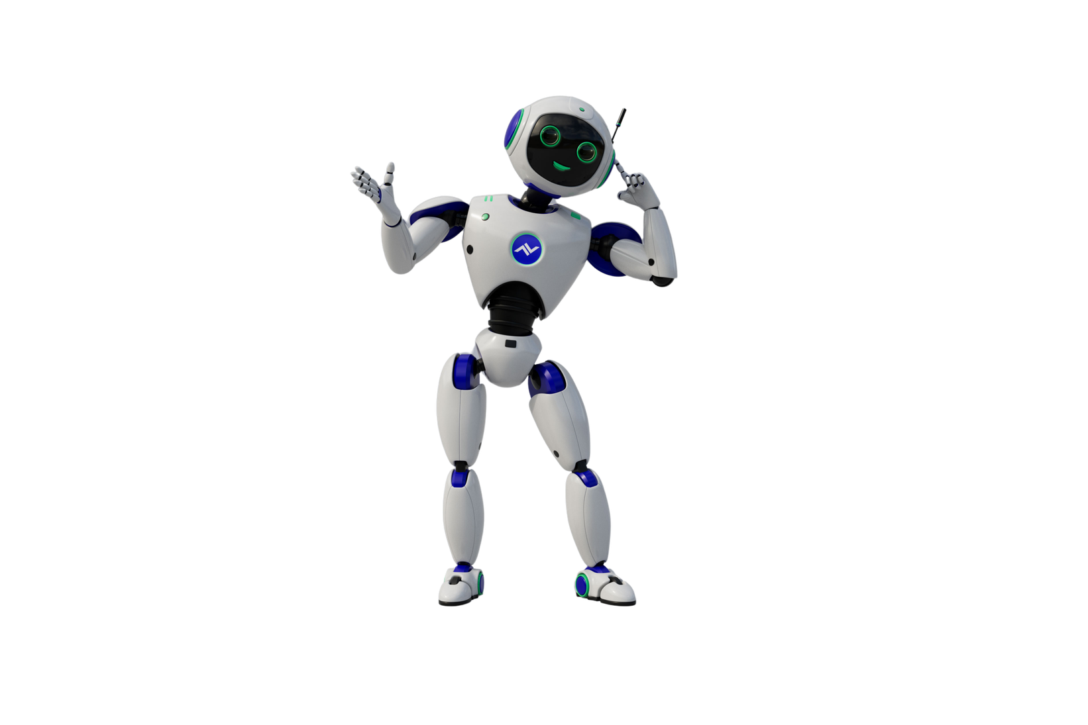

AI Hackathon 2026
Team Pipoca
AI-empower Event Analyser
  Rui Cadete
Turn runtime failures into ready-to-review
user stories and bug tickets.
From production pain to product clarity — automatically.
What was accomplished
Business Impact
Technical Value
Innovation
How We build it
Automatically generates structured bug reports & user stories
Reduce manual bug triage effort
Standardizes issue quality across teams
Deterministic multi-agent Orchestration (not a single prompt)
Structured root cause inference and severity classification
Modular agent design
Practical use of GitHub Copilot Cli as orchestration engine
Role-specialized agents
Defined clear agent responsibilities
Built a deterministic orchestration layer
Expose a REST API for CI/CD integration
Tested with real failure events (Junits/logs)

Slide 2


DEMO TIME!

